Slide 1
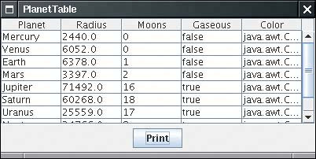
Tables
The JTable component displays a two-dimensional grid of objects. Tables
are common in user interfaces. Tables are inherently complex, but perhaps
more successfully than with other Swing classes the JTable component
hides much of that complexity.
A Simple Table
The data of the table above is stored as a two-dimensional array of Object values:
Object[][] cells =
{
{ "Mercury", 2440.0, 0, false, Color.yellow },
{ "Venus", 6052.0, 0, false, Color.yellow },
. . .
}

Slide 2
public class mytable extends JFrame
{
JTable t=new JTable();
mytable()
{
String head[]={"Book Title","Author Name","Publisher Name","price"};
String values[][]={{"Programming in Java","R.B Patel","TMH","200"}, {"Programming in Java1","R.B Patel1","TMH1","1200"}};
t=new JTable(values, head);
Container c=getContentPane();
c.add(t);
}
public static void main(String a[])
{
mytable m=new mytable();
m.setVisible(true);
m.pack();
}

Slide 3
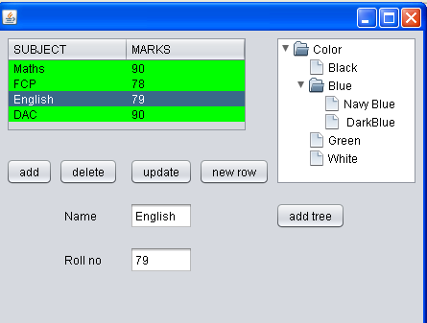

Slide 4
DefaultTableModel table=new DefaultTableModel();
private void addActionPerformed(java.awt.event.ActionEvent evt)
{
jTable1.setBackground(Color.green);
jTable1.setName("student record");
String marks[][]={{"Maths","90"},{"FCP","78"},{"English","79"},{"DAC","90"}};
String header[]={"SUBJECT","MARKS"};
table.setDataVector(marks, header);
jTable1.setModel(table);
}

Slide 5
int i;
private void removeActionPerformed(java.awt.event.ActionEvent evt) {
i=jTable1.getSelectedRow();
t.removeRow(i);
}

Slide 6
private void jTable1MouseClicked(java.awt.event.MouseEvent evt)
{
i=jTable1.getSelectedRow();
jTextField1.setText(jTable1.getValueAt(i, 0).toString());
jTextField2.setText(jTable1.getValueAt(i, 1).toString());
}
private void jButton1ActionPerformed(java.awt.event.ActionEvent evt)
{
Object[] rowdata={jTextField1.getText(),jTextField2.getText()};
table.addRow(rowdata);
jTable1.setModel(table);// TODO add your handling code here:
}

Slide 7
private void updateActionPerformed(java.awt.event.ActionEvent evt)
{
jTable1.setValueAt(jTextField1.getText(), i, 0);
jTable1.setValueAt(jTextField2.getText(), i, 1);
}

Slide 8
Progress Indicators
A JProgressBar is a Swing component that indicates progress.
A ProgressMonitor is a dialog box that contains a progress bar.

Slide 9
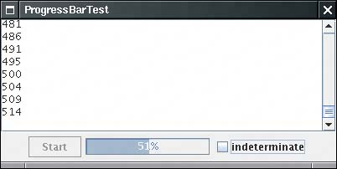
Progress Bars
A progress bar is a simple component just a rectangle that is partially
filled with color to indicate the progress of an operation. By default,
progress is indicated by a string "n%". You can see a progress bar in
the bottom right of Fig below
You construct a progress bar much as you construct a slider, by supplying the minimum and maximum
value :
JProgressBar = new JProgressBar(0, 1000);

Slide 10
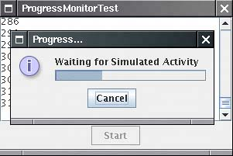
Progress Monitors
A progress bar is a simple component that can be placed inside a
window. In contrast, a ProgressMonitor is a complete dialog box that
contains a progress bar (see Fig below). The dialog box contains a
Cancel button. If you click it, the monitor dialog box is closed.

Slide 11
You construct a progress monitor by supplying the following:
The parent component over which the dialog box should pop up;
An object (which should be a string, icon, or component) that is displayed on the dialog box;
An optional note to display below the object;
The minimum and maximum values.

Slide 12
There are two conditions for termination. The activity might have
completed, or the user might have canceled it. In each of these cases,
we close down:
the timer that monitored the activity;
the progress dialog box;
the activity itself (by interrupting the thread).

Slide 13
package swing1;
import java.awt.*;
import javax.swing.*;
public class progressbarcmd extends JFrame implements Runnable
{
JProgressBar j=new JProgressBar(0, 100);
int num=0; Thread t1;
Container c=getContentPane();
public progressbarcmd() {
c.add(j);
t1=new Thread(this);
t1.start();
}
public static void main(String[] a)
{
progressbarcmd p=new progressbarcmd();
p.pack();
p.setVisible(true);
}

Slide 14
public void run()
{
j.setStringPainted(true);
while(j.getPercentComplete()!=1.0)
{
System.out.println(j.getPercentComplete());
num=num+1;
j.setValue(num);
j.setString(Integer.toString(num));
try
{
Thread.sleep(500);
}
catch(InterruptedException e)
{ }
}
}
}

Slide 15

Progress Bar
class ProgressBar extends JFrame
{
JProgressBar current;
JTextArea ta;
int num = 0;
public ProgressBar()
{
Container pane=getContentPane();
ta=new JTextArea("");
pane.setLayout(new GridLayout());
current = new JProgressBar(0, 100);
current.setValue(0);
current.setStringPainted(true);
pane.add(current);
pane.add(ta);
}

Slide 16
public void iterate()
{
while (num <= 100)
{
current.setValue(num);
try
{
Thread.sleep(500);
}
catch (InterruptedException e) { }
num += 10;
If(num>100)break;
else
ta.setText(num+"%completed");
} }
public static void main(String[] arguments) {
ProgressBar pb = new ProgressBar();
pb.pack();
pb.setVisible(true);
pb.iterate( );
} }

Slide 17
Component Organizers
The advanced Swing features help organize components. These include the
split pane, a mechanism for splitting an area into multiple parts whose
boundaries can be adjusted, the tabbed pane, which uses tab dividers to
allow a user to flip through multiple panels, and the desktop pane, which can
be used to implement applications that display multiple internal frames.

Slide 18
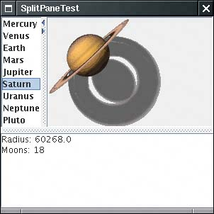
Split Panes Split panes split a component into two parts, with an adjustable boundary in between. Fig below shows a frame with two split panes. The outer pane is split vertically, with a text area on the bottom and another split pane on the top. That pane is split horizontally, with a list on the left and a label containing an image on the right.
You construct a split pane by specifying the orientation, one of
JSplitPane.HORIZONTAL_SPLIT or JSplitPane.VERTICAL_SPLIT, followed by the two components.
For example,
JSplitPane sp = new JSplitPane(JSplitPane.HORIZONTAL_SPLIT, planetList, planetImage);

Slide 19
Split pane
public class splitpanecmd extends JFrame implements ListSelectionListener
{
String ab[]={"hi a","hi b","hi c","hi d"};
JList l1;
JTextArea l1Description=new JTextArea("hello");
Container c=getContentPane();
public splitpanecmd()
{
String[] b={"a","b","c","d"};
l1=new Jlist(b);
JSplitPane sp= new JSplitPane(JSplitPane.VERTICAL_SPLIT,l1,l1Description);
c.add(sp);
l1.addListSelectionListener(this); }

Slide 20
public void valueChanged(ListSelectionEvent e)
{
int g=l1.getSelectedIndex();
l1Description.setText(ab[g]);
}
public static void main(String[] a)
{
splitpanecmd s=new splitpanecmd();
s.setVisible(true);
}

Slide 21
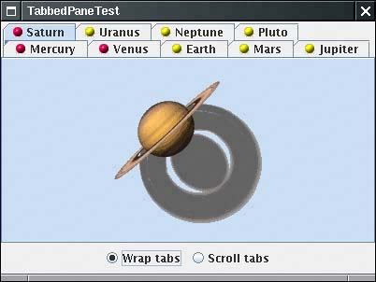
Tabbed Panes Tabbed panes are a familiar user interface device to break up a complex dialog box into subsets of related options. You can also use tabs to let a user flip through a set of documents or images (see Fig below).
To create a tabbed pane, you first construct a JTabbedPane object,
then you add tabs to it.
JTabbedPane tabbedPane = new JTabbedPane();
tabbedPane.addTab(title, icon, component);

Slide 22
package swing1;
import javax.swing.*;
public class tabbedpanedemo extends JApplet
{
public void init() {
JTabbedPane jtp = new JTabbedPane();
jtp.addTab("Cities", new CitiesPanel());
jtp.addTab("Colors", new ColorsPanel());
jtp.addTab("Flavors", new FlavorsPanel());
getContentPane().add(jtp);
} }
class CitiesPanel extends JPanel
{
public CitiesPanel()
{
JButton b1 = new JButton("New York");
add(b1);
JButton b2 = new JButton("London");
add(b2);
} }

Slide 23
class ColorsPanel extends JPanel
{
public ColorsPanel()
{
JCheckBox cb1 = new JCheckBox("Red");
add(cb1);
JCheckBox cb2 = new JCheckBox("Green");
add(cb2);
JCheckBox cb3 = new JCheckBox("Blue");
add(cb3);
} }
class FlavorsPanel extends JPanel
{
public FlavorsPanel() {
JComboBox jcb = new JComboBox();
jcb.addItem("Vanilla");
jcb.addItem("Chocolate");
jcb.addItem("Strawberry");
add(jcb);
} }

Slide 24
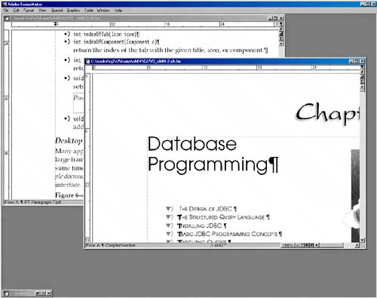
Desktop Panes and Internal Frames Many applications present information in multiple windows that are all contained inside a large frame. If you minimize the application frame, then all of its windows are hidden at the same time. In the Windows environment, this user interface is sometimes called the multiple document interface or MDI. Fig below shows a typical application that uses this interface.

Slide 25
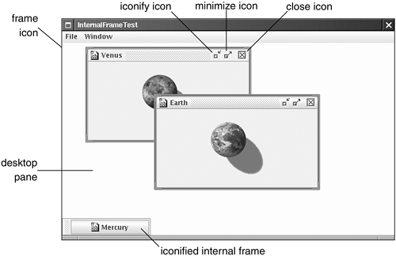
Fig below shows a Java application with three internal frames. Two of
them have decorations on the border to maximize and iconify them.The
third is in its iconified state.
Fig. A Java application with three internal frames

